Slide 1
آشنايي با وسايل و ابزار كمكي مورد استفاده در شیردهي و مشكلات پستاني
Breastfeeding Devices and Equipment
ترانه توانا
مدرس ومربي كشوري شير مادر

Slide 2
THE NIPPLE SHIELD DILEMMA:
TO USE OR NOT TO USE
Nipple shields are often used in the full-term population for assistance with
  latch difficulties as a result of flat or inverted nipples or tight frenulum's, as a barrier if the mother’s nipples are too painful to breastfeed, or to Prevent transmission of nipple or areolar infections and premature infant.

Slide 3
Over the years, nipple shields have evolved from metal, wood, and animal skins, through latex, Mexican-hat style, and bottle teats over the mother’s nipples to today’s ultrathin silicone version.
What is important to note is that the newer silicone shields do not have the same negative effects associated with the others, such as Decreased milk transfer, Decreased nipple stimulation, and Early cessation of breastfeeding.

Slide 4
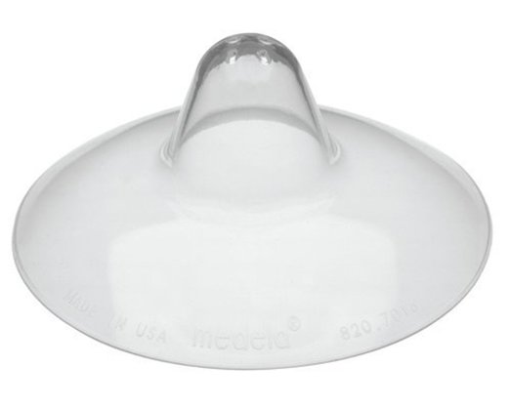
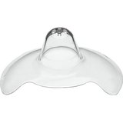
ULTRATHIN NIPPLE SHIELDS
A nipple shield is a thin flexible silicone cover
Nipple shields with a cut-out section enable the infant to have contact with the skin and to smell the mother

Slide 5

Although are not always fully successful, they can be useful in a variety of situation:
  Unable to latch on because of flat or inverted nipples
  Unable to open mouth wide enough to achieve a deep latch
  Unable to draw the nipple/areola into her mouth
  In overactive letdown or oversupply where the baby has difficulty handling the flow
  Nipple/areola are very sore, damaged or infected
  A weak, disorganized, or dysfunctional suck
  There is nipple confusion or breast refusal
  Cleft palate Pierre-Robin syndrome,
  laryngomalacia .. high palate
  feeding the late preterm infant
Notes:
an infant who has been fed with a bottle is learning to feed at the breast

Slide 6
NIPPLE SHIELDS IN LATE PRETERM INFANT
Improvement of suckling and milk transfer is usually evident after the first attempt with the nipple shield.
when circumstances occur that may result in disruption or cessation of breastfeeding, nipple shields might be a safe tool to manage effective breastfeeding when other interventions have failed.

Slide 7
INDICATIONS FOR LATE PRETERM INFANT
Because of the lack of this buccal pad fat, which would have developed after 37 weeks gestation, the late preterm baby has a large area of dead space in his or her mouth. Nipple shields help fill the mouth, decreasing the dead space and thereby assisting the late preterm infant to breastfeed using less energy.
Another appropriate use of nipple shields for the late preterm infant is to control the rate and strength of milk flow from the mother’s breast to an appropriate degree for the baby to effectively manage without choking.

Slide 8
The third reason for using a nipple shield when feeding these late preterm infants is to increase the likelihood of the baby having frequent sustained suckling patterns.
    Myelination of the spinal cord does not begin until 36 weeks gestation.
    Because the mother’s breast tissue is very pliable, it may not give a strong enough impulse to the baby’s brain to encourage suckling from the baby.
    More rigid feeling of the silicone nipple shield and the amount of substance coming into contact with the baby’s tongue and roof of his or her mouth encourage much more rapid firing of neurons, which may lead to an increased stimulus to suck.

Slide 9
lactation consultants, and mothers actually were instructed on correct application, one must remember that incorrectly applying the nipple shield or incorrect sizing of the shield can have a drastic negative effect on
Milk transfer,
Maternal hormone levels,
Nipple pain and trauma, and
Breastfeeding experiences.

Slide 10
NIPPLE SHIELD OPTIONS
The size of the nipple shield(16-mm, 20-mm, and 24-mm sizes)
  correct size for both the mother and baby. :
    If incorrectly used milk transfer, increased nipple pain, and, possibly, visible nipple damage. the baby may expend a large amount of unnecessary energy trying, leading to fatigue and weight loss.
    If the shield is too big, the baby might have difficulty latching deep enough
    If the nipple shield is too small, the mother’s nipples might not fit in the tip and there definitely won’t be enough breast tissue for the baby to latch onto, which will decrease the amount of milk transfer and increase nipple pain.

Slide 11
The largest nipple shield that suits both the baby and the mother should be used.
If using a shield other than the largest 24mm shield available, attempts should be made every few days to advance to the larger size, and once the baby graduates to using the larger size, he or she should not go back to using the smaller one.

Slide 12
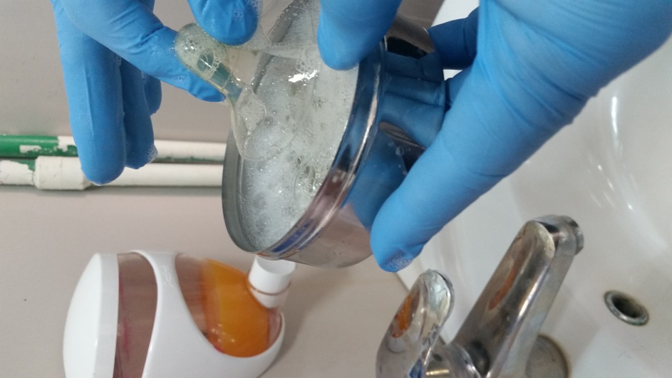
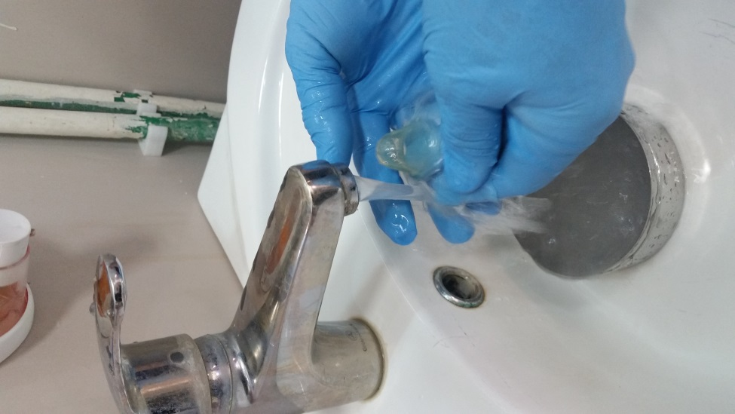
Applying the Nipple Shield
It should be washed with hot, soapy water and then rinsed with hot water.

Slide 13
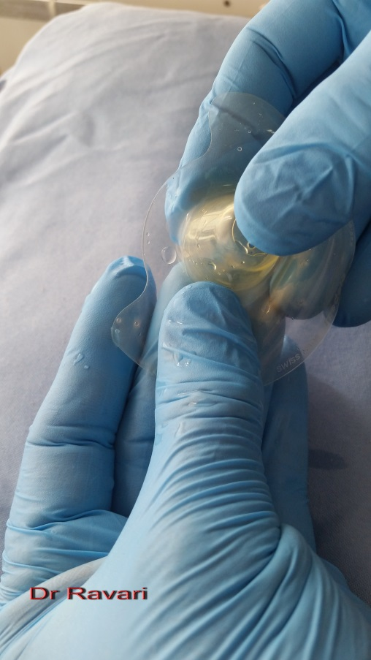
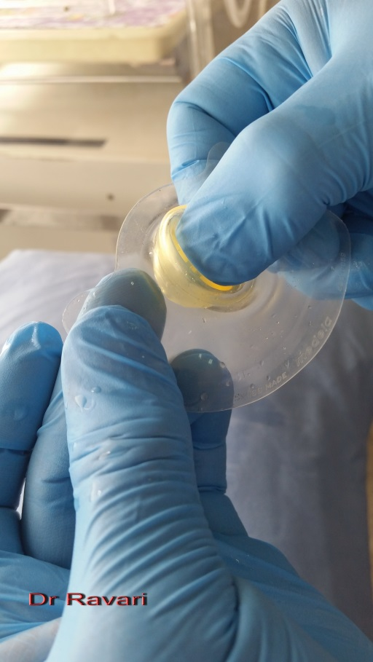
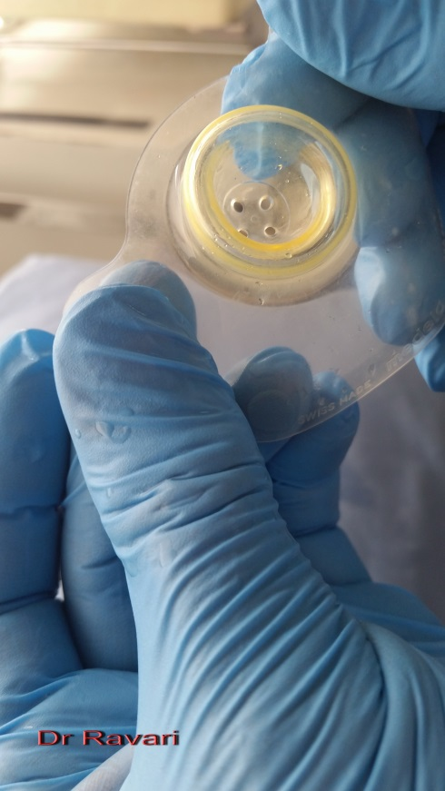
Start by pushing down on the nipple part with your thumb, while pulling up from the bottom with your fingers.
Nipple tip pushed down halfway

Slide 14

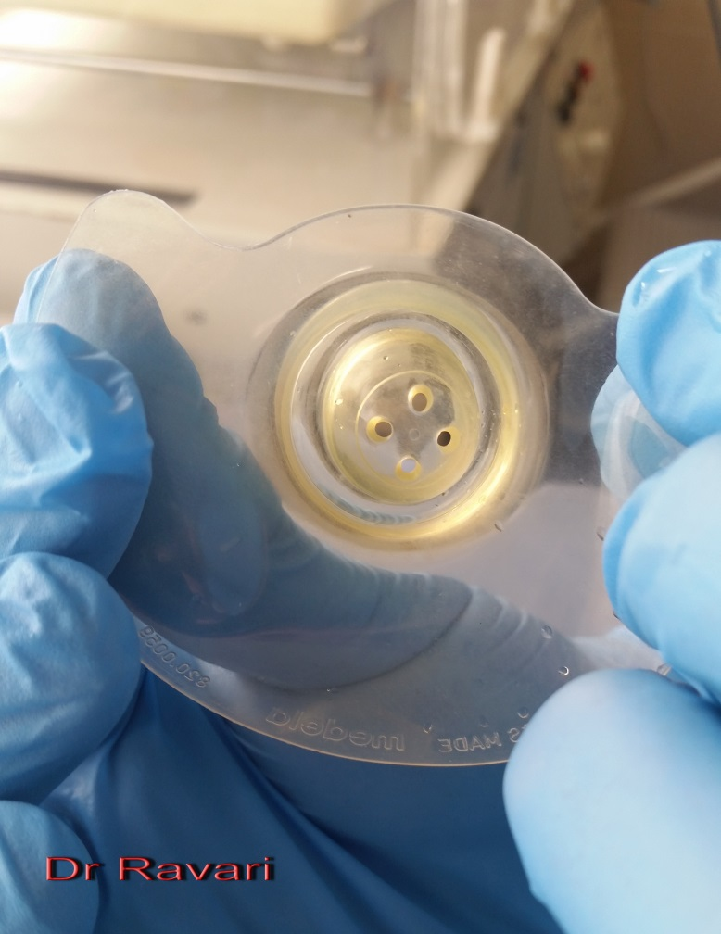
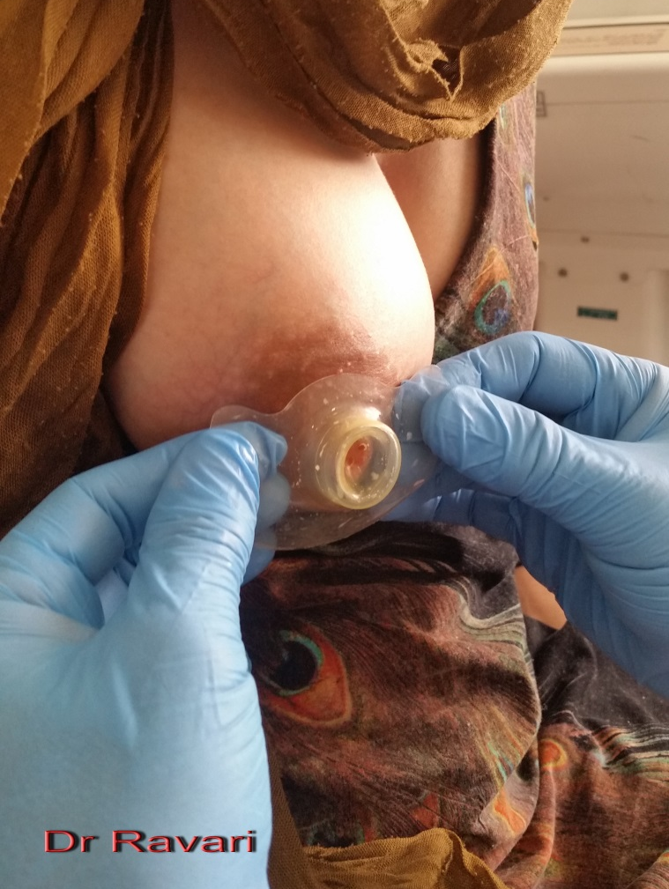
Place the tip of the nipple shield centered over the tip of the nipple, pushing into the breast gently but firmly to create a seal

Slide 15
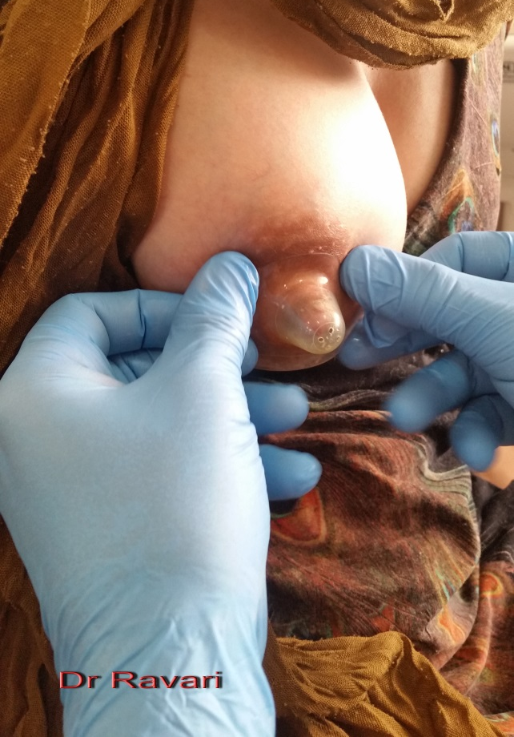
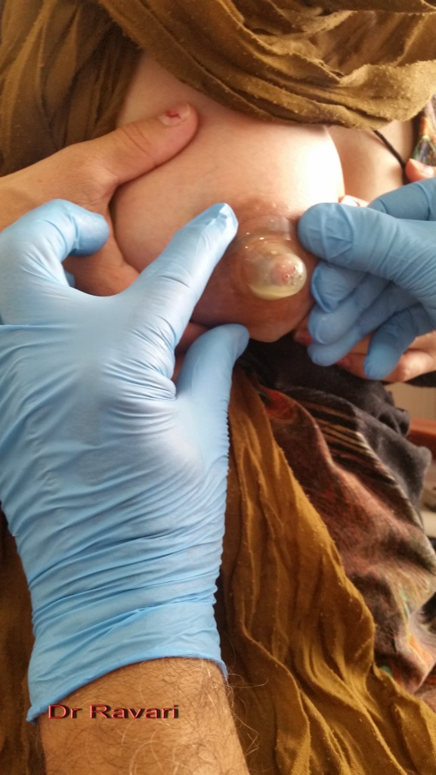
While pushing gently into the breast, insert a finger from each hand into the ridge between the nipple part of the shield and the outer part of the shield. Fingers should be parallel to the nipple

Slide 16
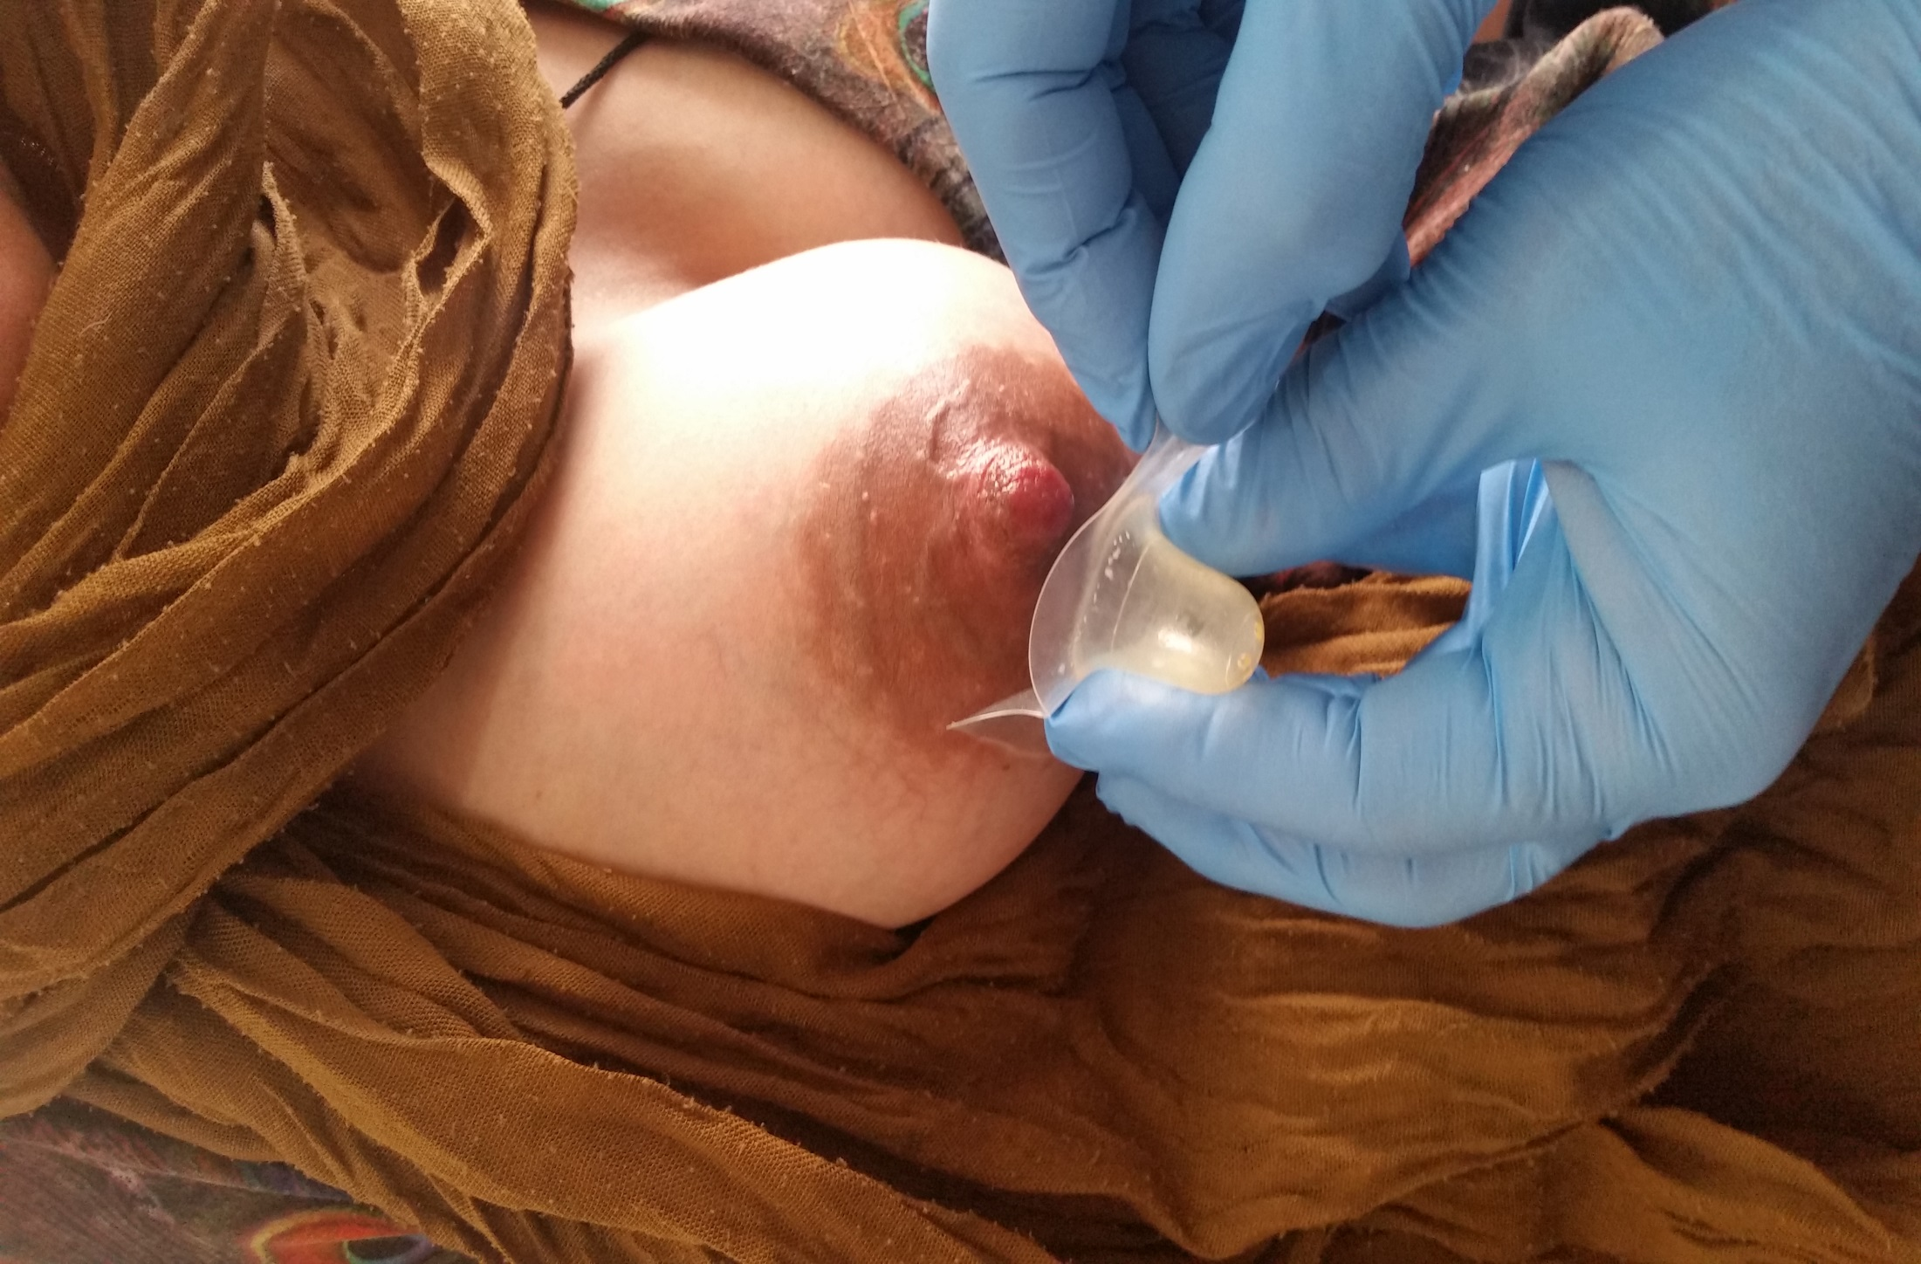
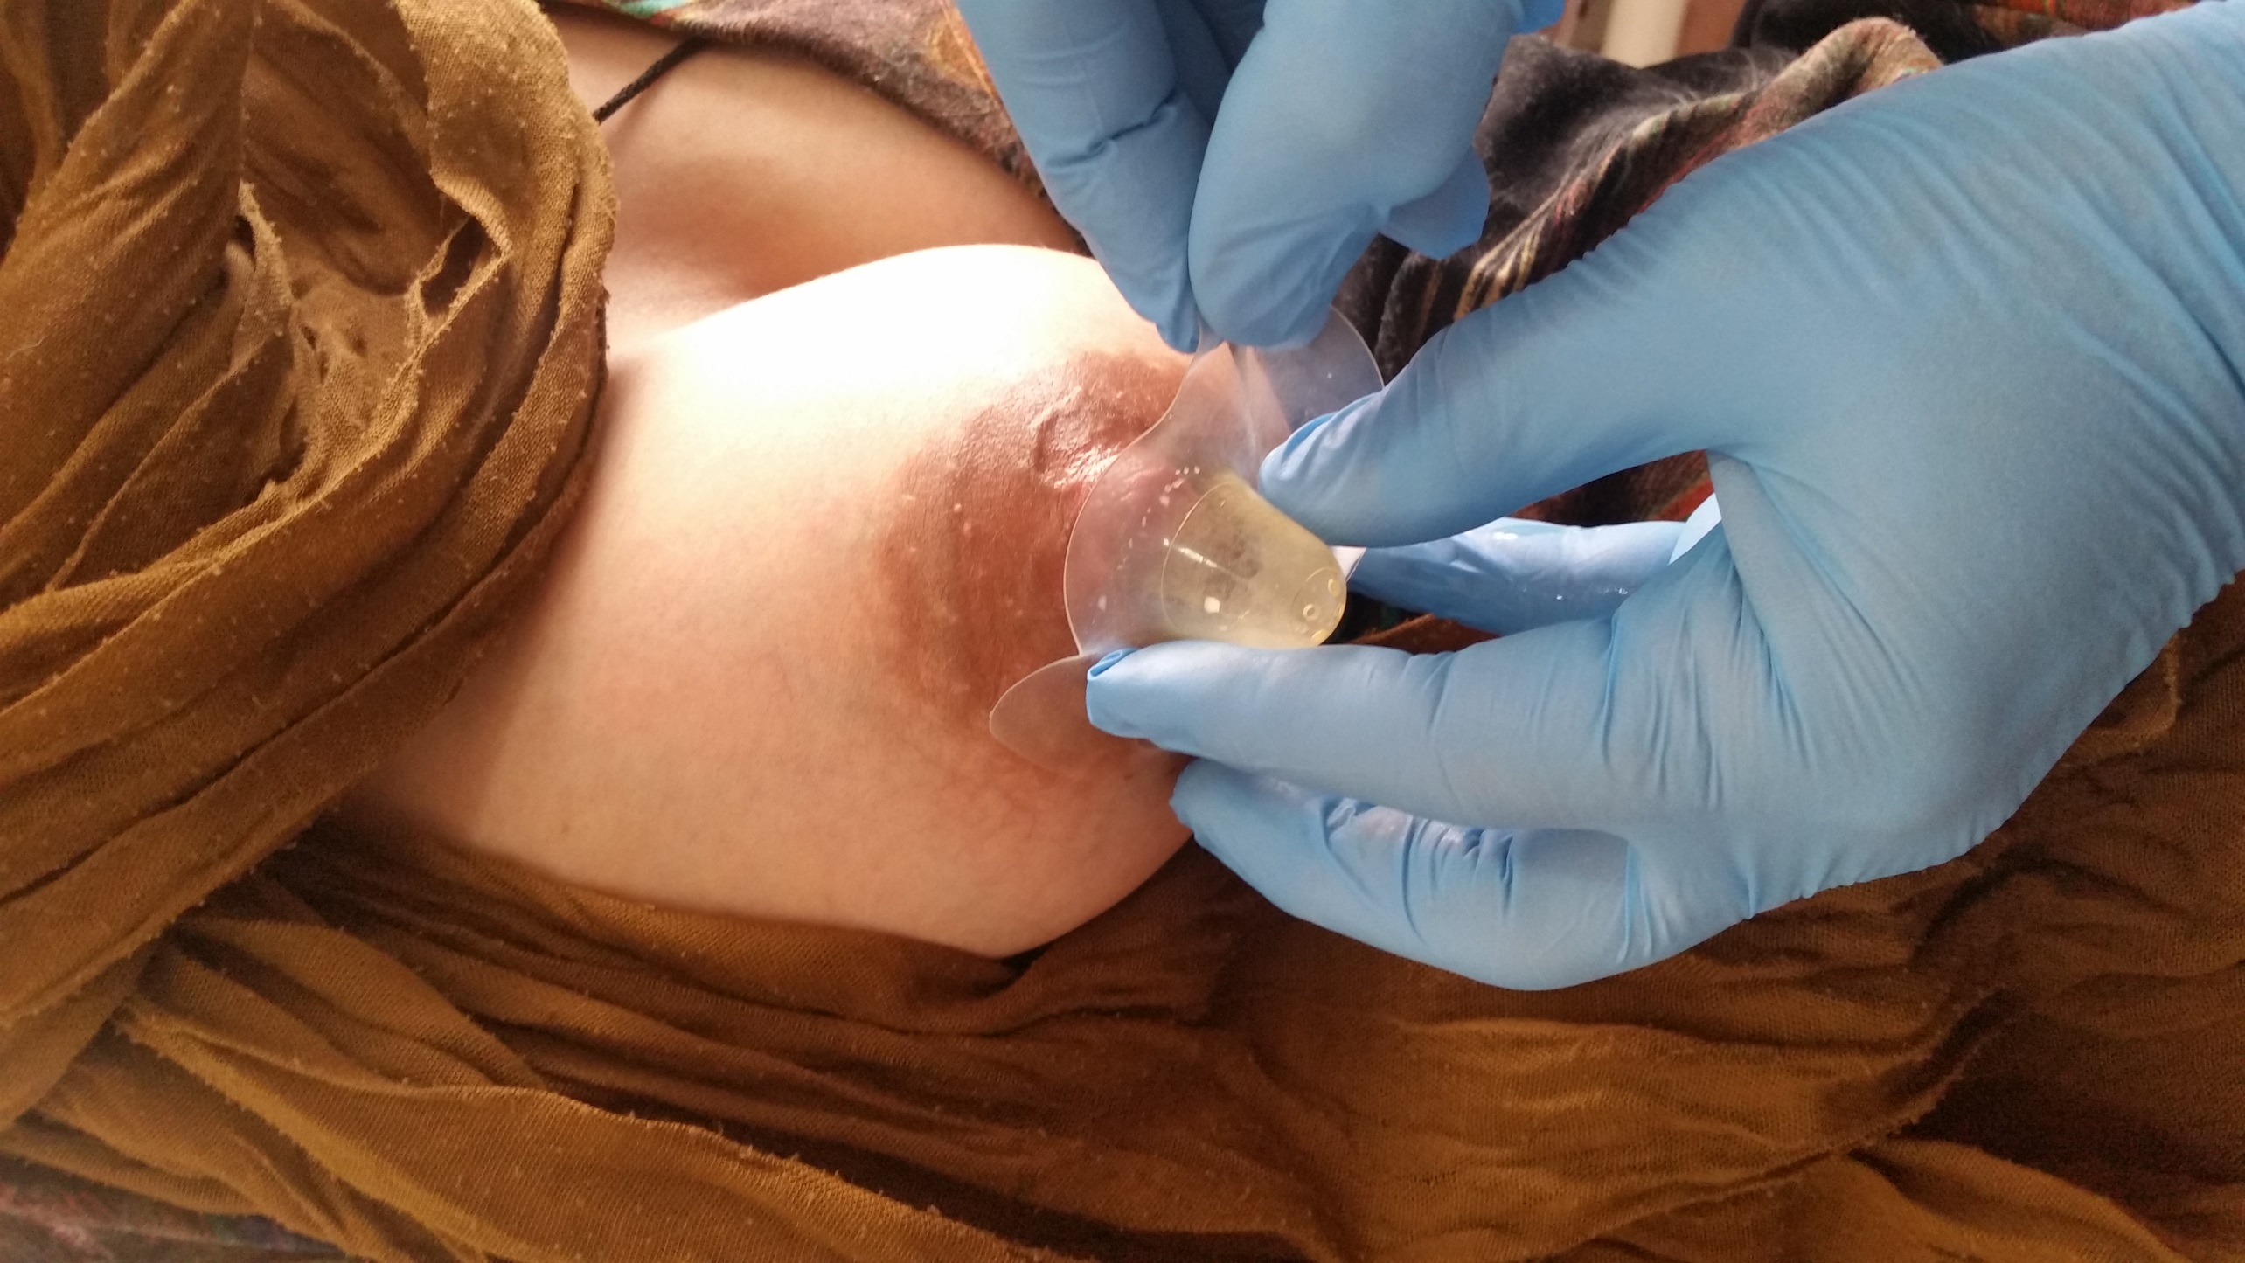
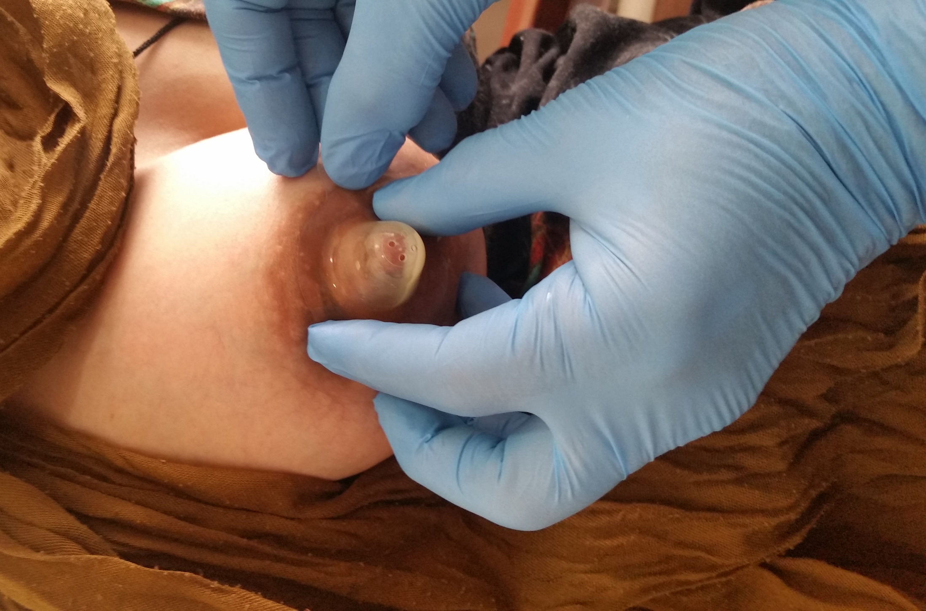
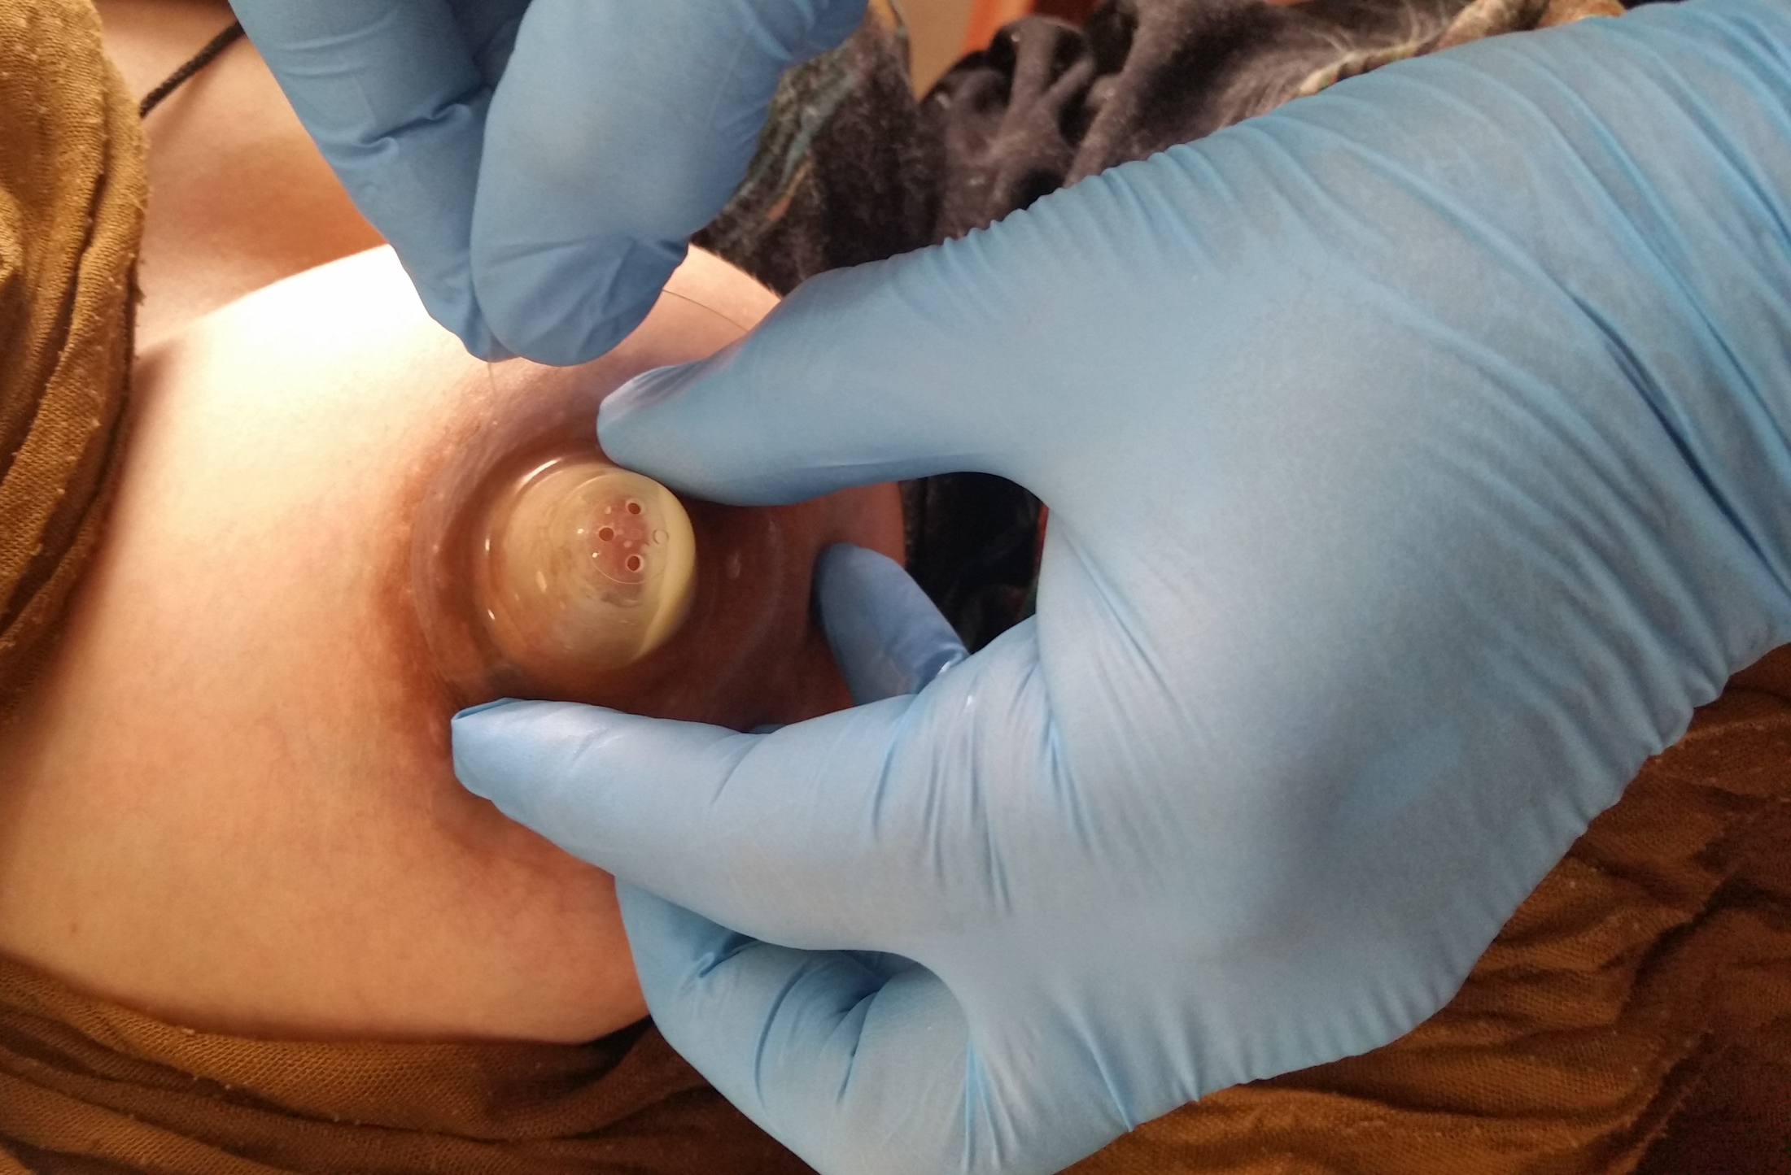
Applying the Nipple Shield
the nipple
remove the nipple shield from the breast

Slide 17
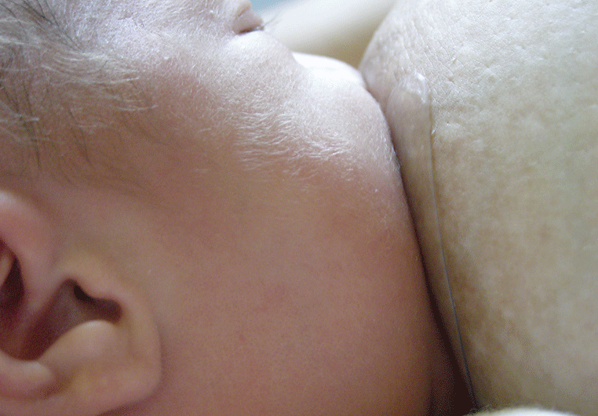
Optimal attachment technique during the use of a nipple shield

Slide 18
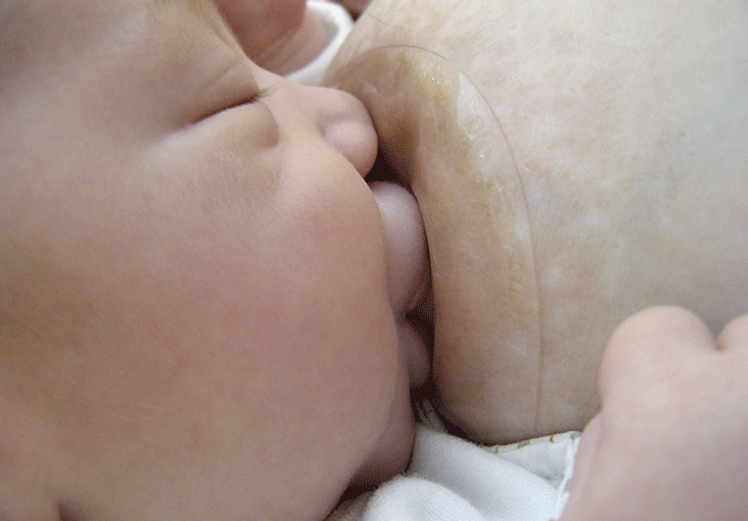

An incorrect attachment technique with the use of a nipple shield can result in injuries to the nipples

Slide 19
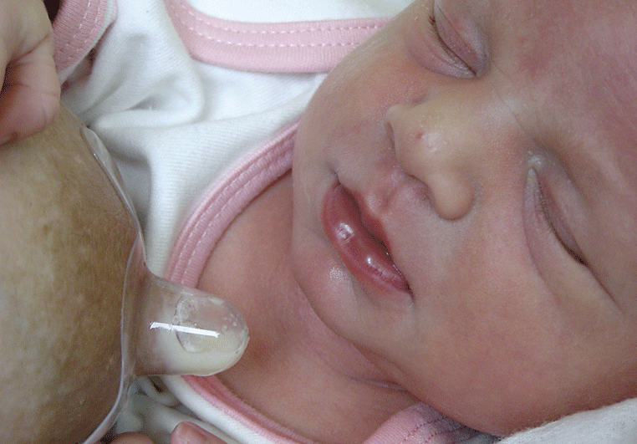
A good sign after breastfeeding: milk in the nipple shield and a satisfied infant

Slide 20
Breast shells
A two piece plastic device consisting of a dome or cup..
Uses :
  To evert flat or inverted nipples either prenatally or postpartum
  To collect leaking milk
  To relive engorgement (Breast shells 20 minutes before feeding)
  For protection of painful, tender nipples

Slide 21
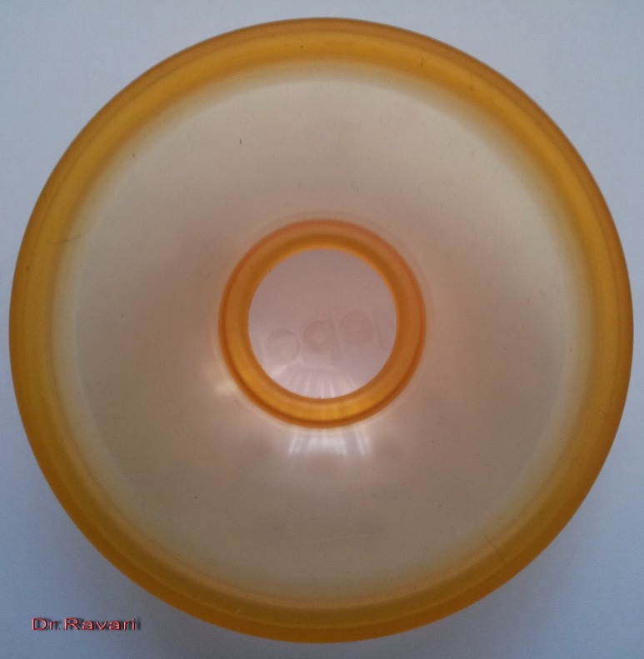
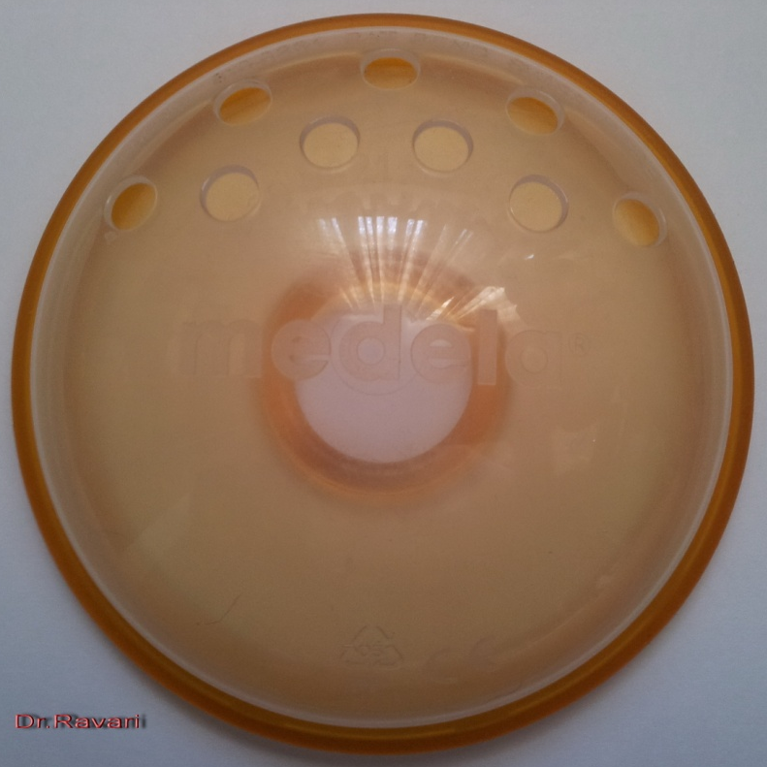
Breast shells

Slide 22
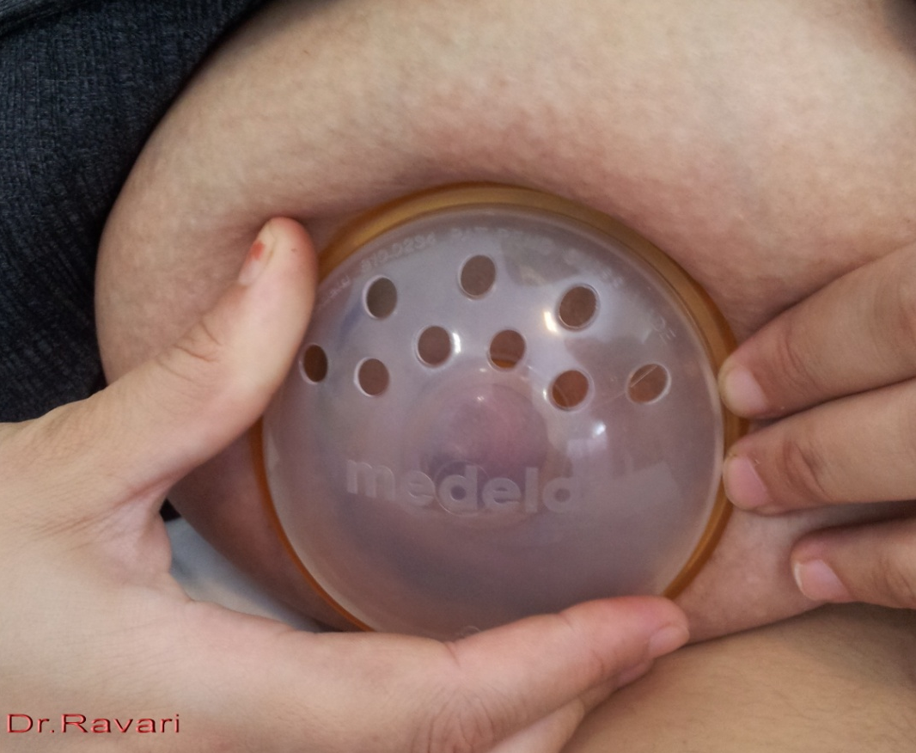
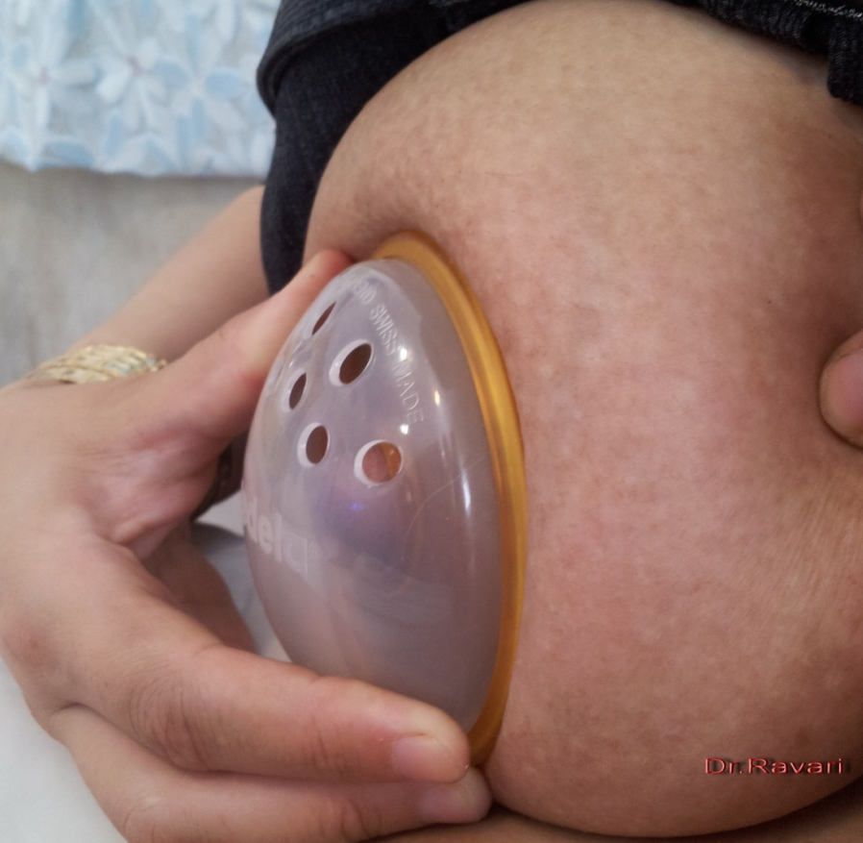
Breast shell on the breast

Slide 23
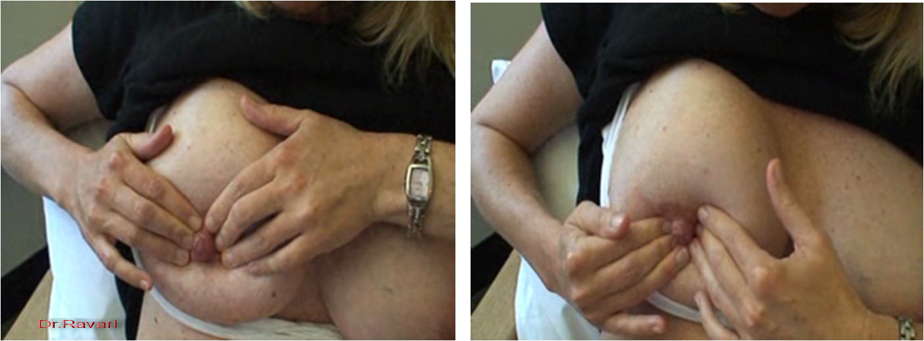
Reverse Pressure Softening technique (hand method)
Hold the pressure steady for a period of 1 to 3 full minutes

Slide 24


Reverse Pressure Softening technique (hand method)
Hold the pressure steady for a period of 1 to 3 full minutes

Slide 25

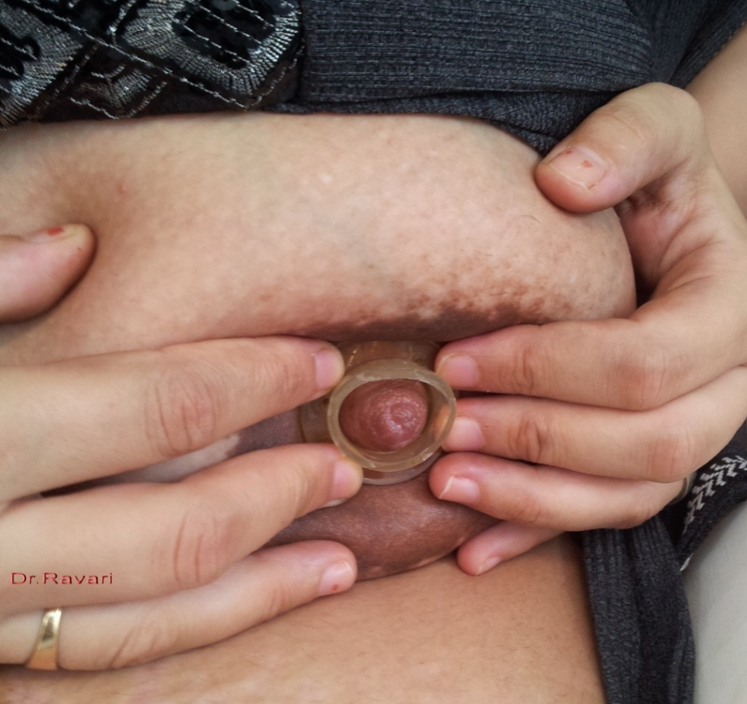
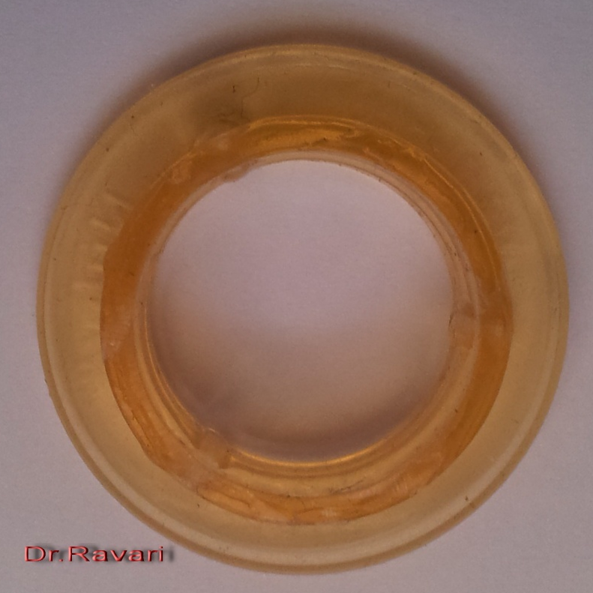
Hold the pressure steady for a period of 1 to 3 full minutes

Slide 26
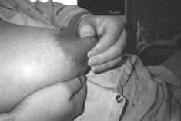
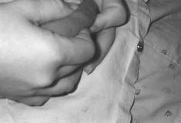
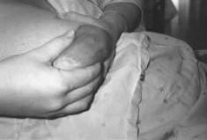
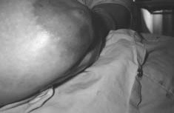
Treating Postpartum Breast Edema With Areolar Compression
The procedure will take anywhere from a few minutes to 30 minutes, depending on the severity of the breast edema.
Notes:
The procedure will take anywhere from a few
minutes to 30 minutes, depending on the severity of the breast
edema.
Figure 1. The mother applies pressure with her fingers into the
areola behind the nipple. She does a “press test.”
Figure 2. The fingers left impressions in the tissue after release of
pressure.
The mother’s fingers are then placed behind the initial
“pit,” and the tissue is pressed and held. The mother
works her way up the areola and then rotates to a new
area behind the nipple to start the process again.
The nipple is pliable and easily grasped with the fingers
and stretched outward.

Slide 27

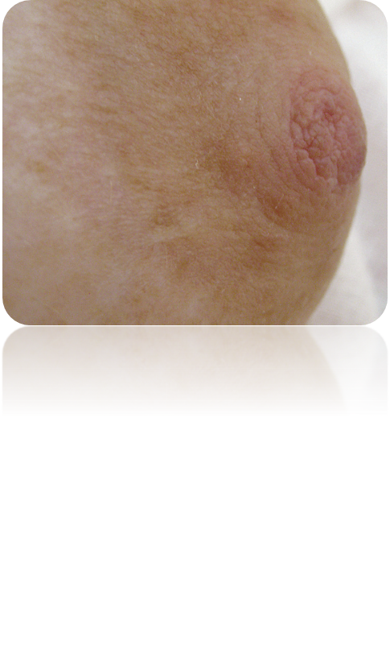

Slide 28
Small or Flat nipples
Flat nipples may be almost indistinguishable from the areola, or protrude only slightly with stimulation.
Flat nipples respond to the same passive treatment with a breast shell that works for inverted nipples. The shells can be worn during the last trimester by women who choose to do so

Slide 29
BREASTFEEDING WITH
SMALL OR FLAT NIPPLES
If your nipples are only mildly flat, your baby may be able to attach himself to the breast without any special help.
If not, try gently compressing the areola before a feed to make the nipple as erect as possible before offering it to your infant.
Using the breast shell between feedings will help draw the nipple to greater prominence.
In the case of flat nipples, the (temporary) use of nipple shields may be useful.

Slide 30
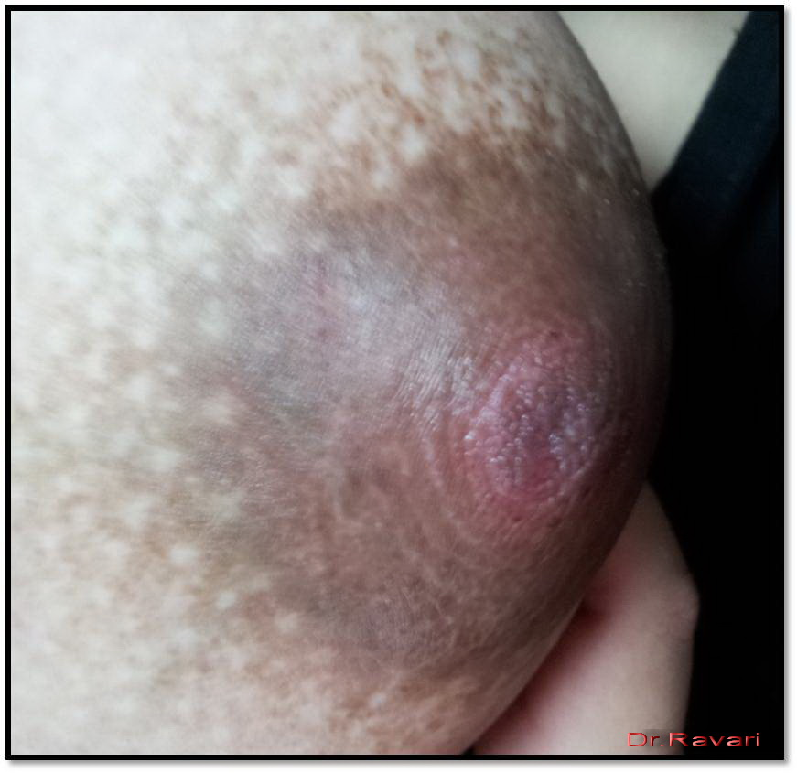
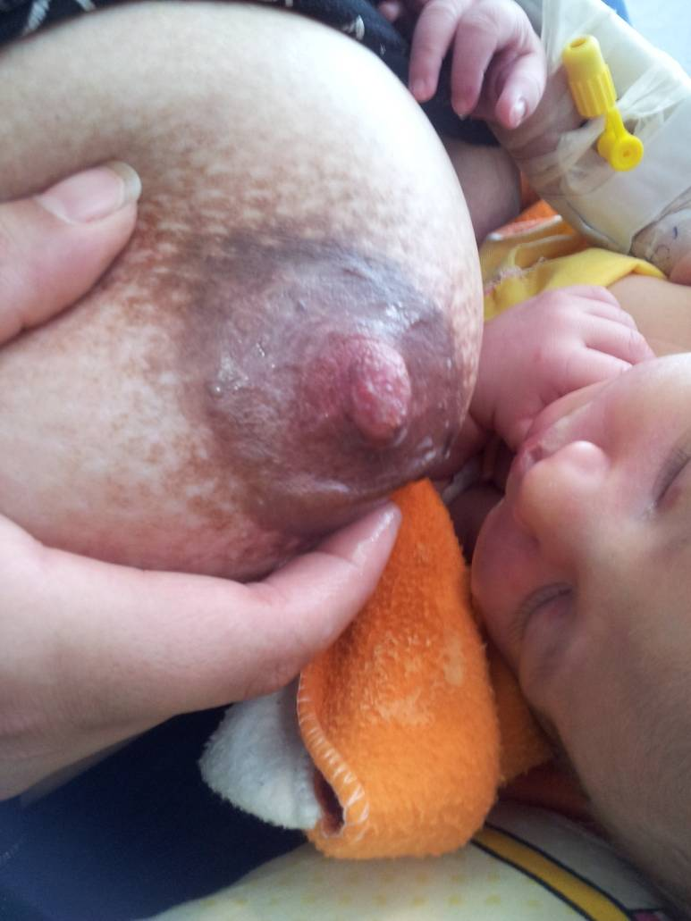
Flat nipple before and after attachment

Slide 31
Drawing the nipple out with a hospital electric pump or other suction (Nipple Everters, Inverted syringes) before each feeding should help facilitate latch-on and train the infant to a proper grasp.
A day or two of such preparation with the pump is usually sufficient if the infant is full term with a good suck.

Slide 32
Nipple Everters
Evert a flat or retracted nipple in the prenatal or postnatal period
Form a nipple to make latch-on easier for a baby who is having difficulty grasping and holding the nipple
The mother applies the suction and gently pulls back on the plunger to her level of comfort and holds the nipple everted for about 30 seconds
  she preforms this action prior to each breastfeeding and can repeat between feeding if desired

Slide 33
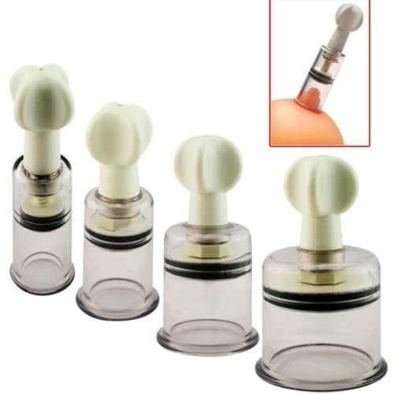
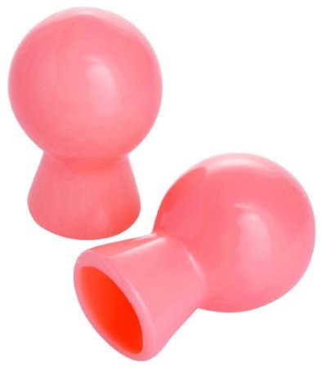
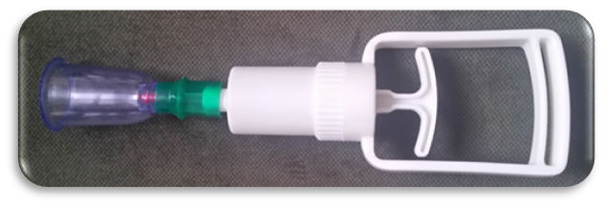
Nipple Everters

Slide 34
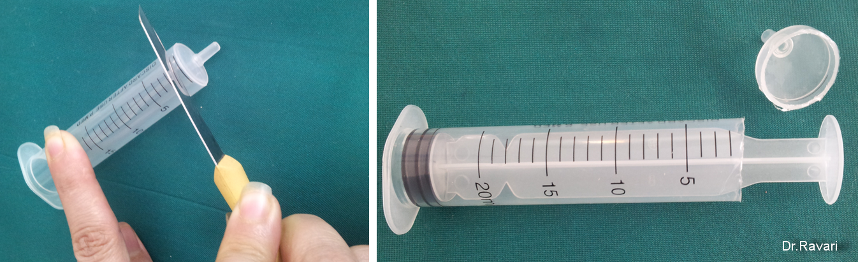
Inverted syringes

Slide 35
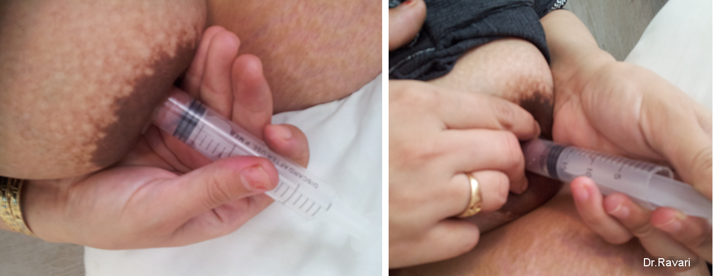

Slide 36
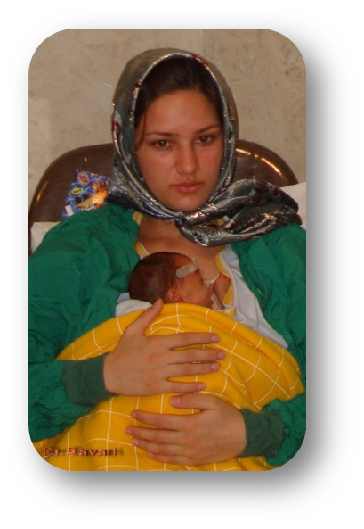
ALTERNATIVE METHOD OF BREASTFEEDING

Slide 37
Oral feeding
Baby-led
(baby can control the length of the feed and the amount taken)
  Breastfeeding, Cup-feeding
Career-led (baby has no control of the amount or the pace of the feed)
  Tube, Syringe, Dropper, Spoon, Bottle
Notes:
Baby-led که شيرخوار در مقدار و مدت تغذيه شرکت نموده وشامل تغذيه مستقيم از پستان مادر و يا استفاد از فنجان می باشد
Carer-led که در اين مورد شيرخوار هيچ اختياری در مقدار و فواصل تغذيه نداشته و شامل استفاده از
لوله بيني به معده يا دهان به معده ،
سرنگ يا قطره چكان، قاشق و
بطری می باشد.

Slide 38

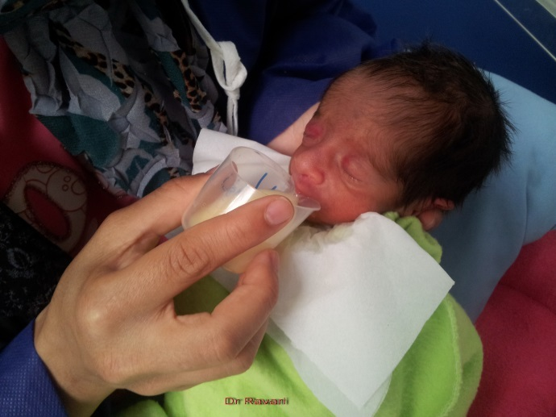
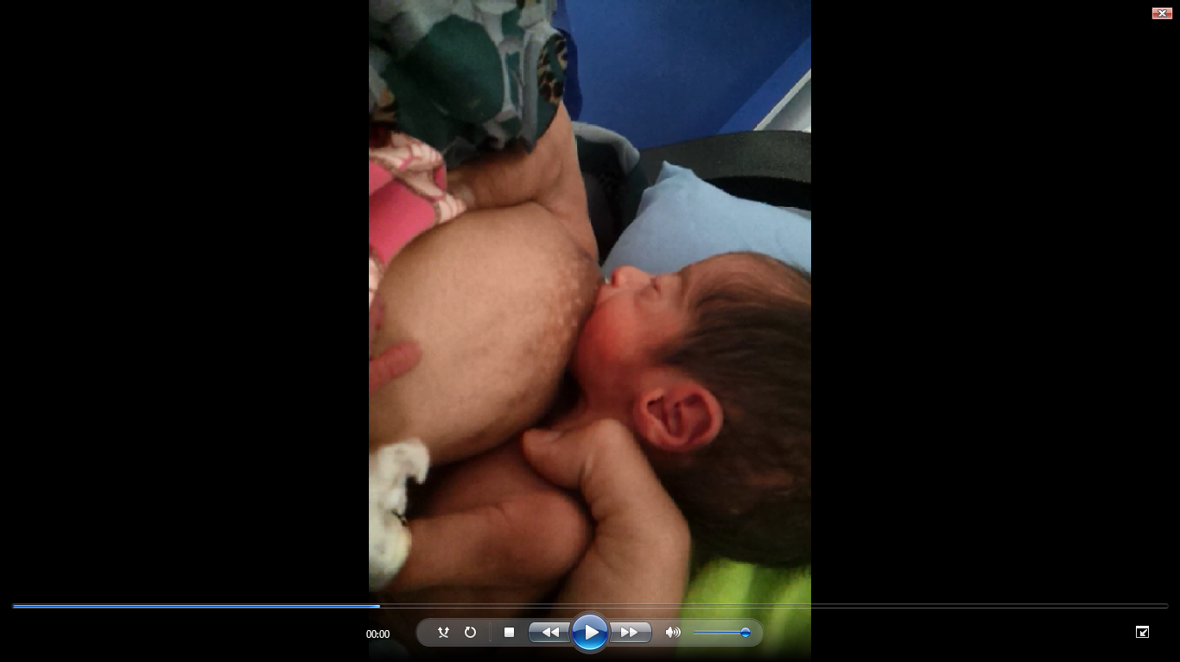
Skilled health professionals knowledgeable about breastfeeding management are an important element of the support of the mother in her goal to breastfeed.
The mother and health care team should establish a breastfeeding plan.
Mother's breastfeeding plan should be regularly reviewed to ensure it reflects the infant's current state of development.

Slide 39
استفاده از شيرمادر براي نوزادان نارس يک امر حياتي است
شيرمادر نوزاد نارس اختصاصي ترين و اصلي ترين منبع تغذيه و بهترين انتخاب برای نوزاد نارس
تشويق و تسريع در برقراري تغذيه دهاني ،تقويت سيستم ايمني ، کاهش موربیدیتی و مرتالیتی نوزاد
یک برنامه کليدي براي تسهيل در ايجاد روابط عاطفي مادر ونوزاد
تخليه سريعتر معده و رزيدوي کمتر نسبت شيرمصنوعي
اقامت کمتر در بيمارستان بعلت
Full Enteral Feeding شدن سريعتر
Notes:
استفاده از شيرمادر براي نوزادان نارس يک امر حياتي است که باعث تشويق و تسريع در برقراري تغذيه دهاني وتقويت سيستم ايمني آنها شده و همچنين يک برنامه کليدي براي تسهيل در ايجاد روابط عاطفي مادر ونوزاد مي باشد.

Slide 40
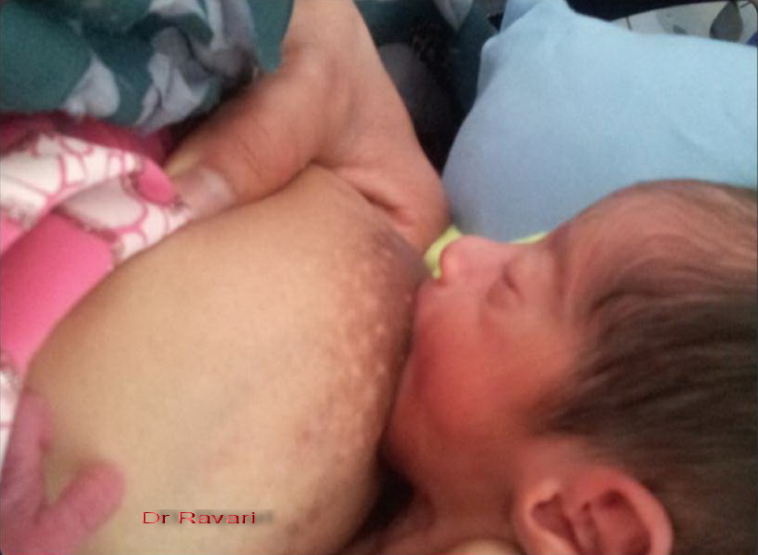
اهميت آموزش مادربراي شیردهی و دوشيدن شير
نوزاد نارس هنوز مکيدن موثر براي تخليه پستان ندارد
اختلال در انتقال شیر از پستان >.>>> کاهش تولید شیر

Slide 41

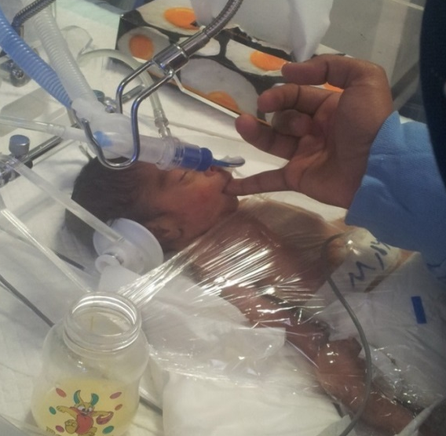

آگاهی و مهارت پزشک و پرستار در مدیریت شیردهی عامل بسیار مهمی در حمایت مادر به رسیدن هدف وی که همان تغذیه با شیرمادر است می باشد.
BW:1.250 RDS Surfact.NIV.CPAP.
Wt 6mo:6kg Exclusive Breastfeeding
Notes:
Skilled health professionals knowledgeable about breastfeeding management are an important element of the support of the mother in her goal to breastfeed.
The mother and health care team should establish a breastfeeding plan.
Mother's breastfeeding plan should be regularly reviewed to ensure it reflects the infant's current state of development.

Slide 42
Feeding low-birth-weight babies
32 weeks gestation
  able to start suckling from the breast
30-32 weeks gestation
  can take feeds from a small cup or spoon
Below 30 weeks gestation
  usually need to receive feeds by tube in hospital
The breastfeeding infant needs not only the ability to suck and swallow-reflexes normally very early in gestation-but also the ability to coordinate suck and swallow with breathing, which appears around 32 weeks of gestation

Slide 43
Droppers
Provide milk incentives at the breast in order to achieve latch-on
supplementary feeding
Temporary aid to improve suck organization
Advantages:
  Avoids the use of artificial nipples
  Inexpensive and widely available
  Easy to use and teach parents
  Quick way for to receive small amounts of milk while learning to breastfeed
  Baby may be more eager to breastfeed because suckling needs are not met
کمکی
موقت
مزایا
Dr Ravari
Notes:
43

Slide 44
Disadvantages:
  Difficult to clean
  Must be continually refilled
  Baby dose not learn to suck unless in conjunction with finger feeding
  Time consuming
Technique
  Placed into the corner of the baby mouth while latching on to breast
  One or two drop can be placed on the tongue to initiate swallowing and sucking
  If using with a finger, place the filled dropper along the side of the finger into baby mouth
Dr Ravari
Notes:
44

Slide 45
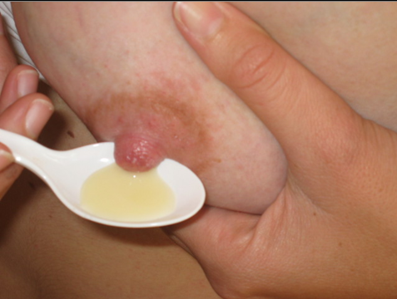
Spoons
Advantages
  Avoids the use of artificial nipples
  Inexpensive and widely available
  Easy to use and teach parents
  Can be used for very small amounts of milk (colostrum)
  Baby may be more eager to breastfeed because suckling needs are not met
Dr Ravari

Slide 46
Spoon-feeding (Technique)
The baby should be alert with a functioning swallow reflex
Position the baby in a semi-upright
Place the spoon just inside the infant's lips over the tongue
Allow the infant to pace the feeding by sipping or lapping
Avoid pouring the milk into the baby's mouth
Dr Ravari

Slide 47
syringes
Types
  The mother may be able to express colostrum into a regular syringes )1 ml, 2ml or 5ml) directly from the nipple as the mother expresses it.
  The sharp opening of the syringe could cause damage to the infant’s oral cavity.
  Periodontal syringe, 10ml with a curved tip
Provide milk incentives at the breast in order to achieve latch-on
Complementary feeding
Notes:
47

Slide 48
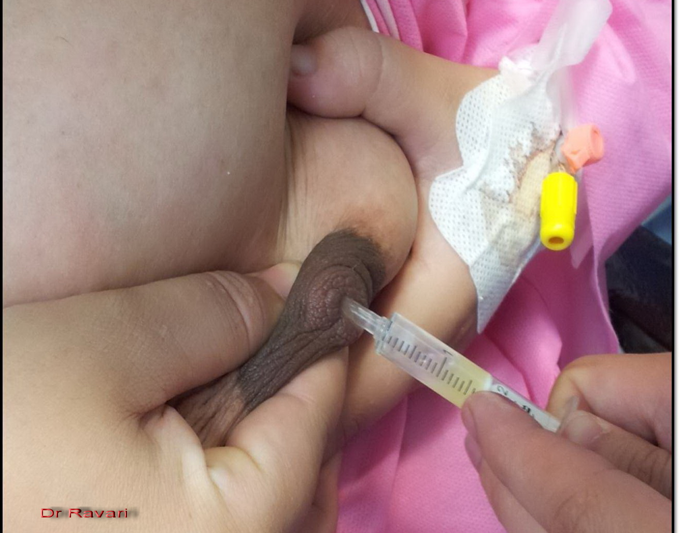

Slide 49
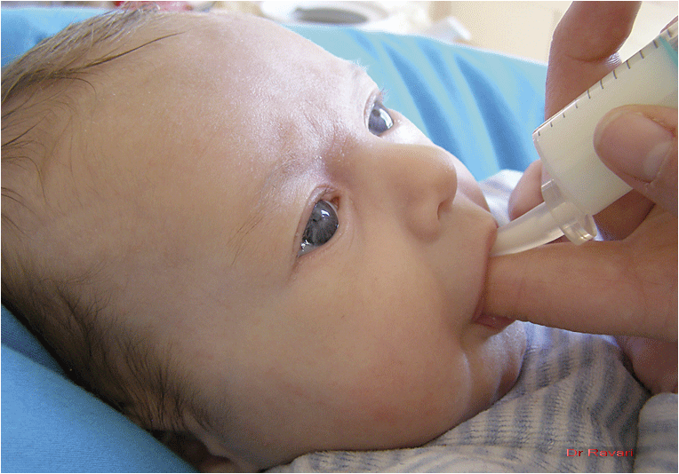
Finger-feeding with a periodontal syringe (glove optional)

Slide 50

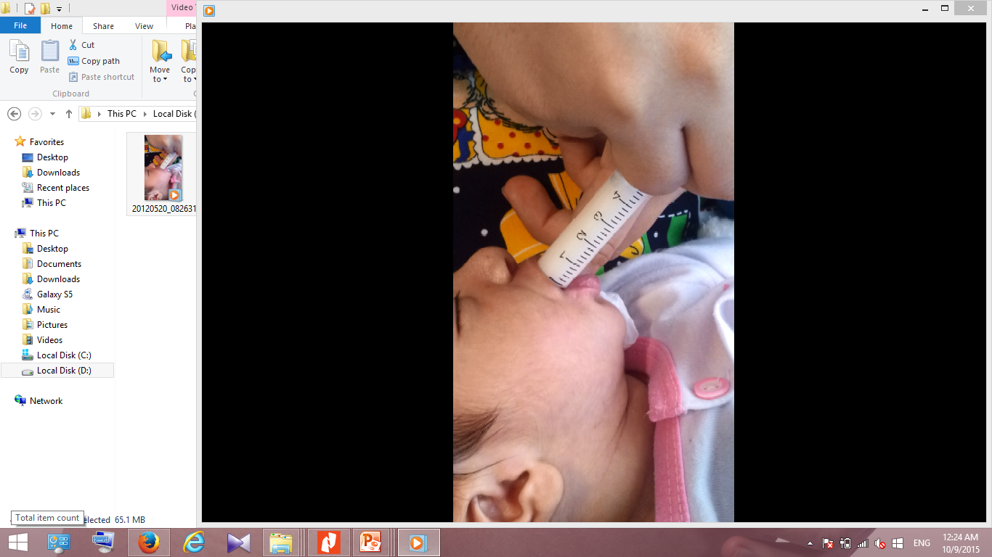
A syringe can be used to drip expressed breast milk onto the breast just above the baby’s lips when he or she is latched. This allows the milk to drip into the baby’s mouth as he or she is suckling.
At the breast; insert the tip of the syringe just inside the infant's lips at the corner of his or her mouth give a small bolus of milk(0.5cc) when the infant sucks.
Use the finger with syringe.
Notes:
50

Slide 51
Cup Feeding
Cup feeding is the choice of an alternative oral feeding method, when full oral feeding cannot be achieved wholly by breastfeeding
تغذیه با فنجان انتخاب یک روش تغذیه خوراکی جایگزین است، زمانی که تغذیه کامل خوراکی نمی تواند به طور کامل با شیردهی به دست آید.

Slide 52
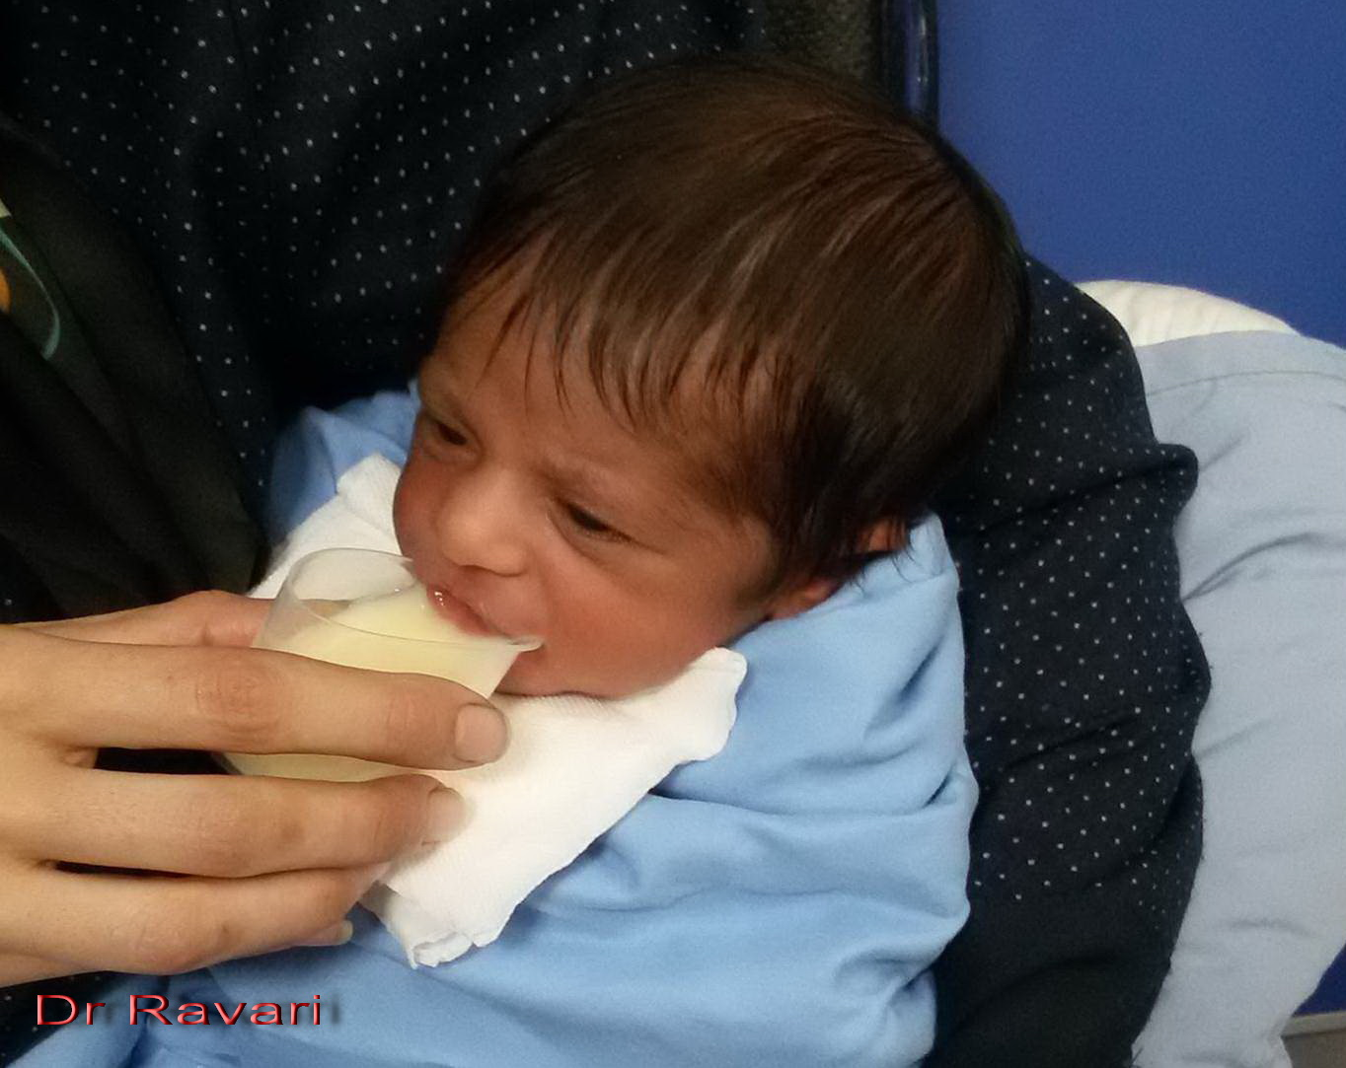

Slide 53
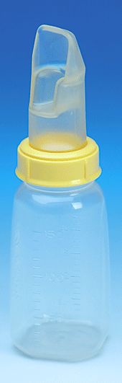
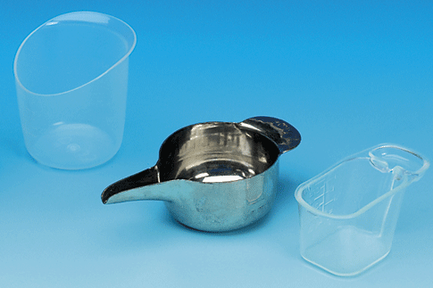
Paladai cup

Slide 54
Why cup feed?
Mother ill ,and separation
Baby not latching on
Damaged nipple
Use with both term and preterm infants to avoid bottle nipple preference
Preterm baby (who cannot take sufficient from the breast)
Switch from gastric tub or bottle to breast
In Supplementary feeding
مادر بیمار و جدایی .کودک چفت نمیشه نوک سینه آسیب دیده .نوزاد نارس (که نمی تواند مقدار کافی از سینه را مصرف کند)

Slide 55
Why cup feeding is recommended
چرا تغذیه فنجانی توصیه می شود
It is pleasant for the baby close with eye-contact
Avoids the use of artificial nipples
It allows the baby to use his or her tongue helps the to learn to breastfeed because he must stick out tongue to drink from cup and to learn tastes
It stimulates the baby’s digestion
It encourages coordinated breathing/suck/swallow
It allows baby to control the amount and rate of feeding
A cup is easier to keep clean than a bottle and teat
Easy to use and to teach parents to use
Reduces the incidence of bottle-feeding associated apnea and bradycardia in preterm infants
Good weight gain
برای نوزاد با تماس چشمی خوشایند است از استفاده از نوک سینه مصنوعی خودداری می کند این اجازه می دهد تا کودک از زبان خود استفاده کند و به او کمک می کند تا شیردهی را یاد بگیرد زیرا باید زبانش را بیرون بیاورد تا از فنجان بنوشد و مزه ها را یاد بگیرد. هضم غذای کودک را تحریک می کند تنفس/مکیدن/بلع هماهنگ را تشویق می کند این به کودک اجازه می دهد تا میزان و سرعت تغذیه را کنترل کند تمیز نگه داشتن فنجان راحت تر از بطری و سرپستانک است آسان برای استفاده و به والدین آموزش استفاده از کاهش بروز آپنه و برادی کاردی مرتبط با تغذیه با شیشه شیر در نوزادان نارس افزایش وزن خوب
Dr Ravari

Slide 56
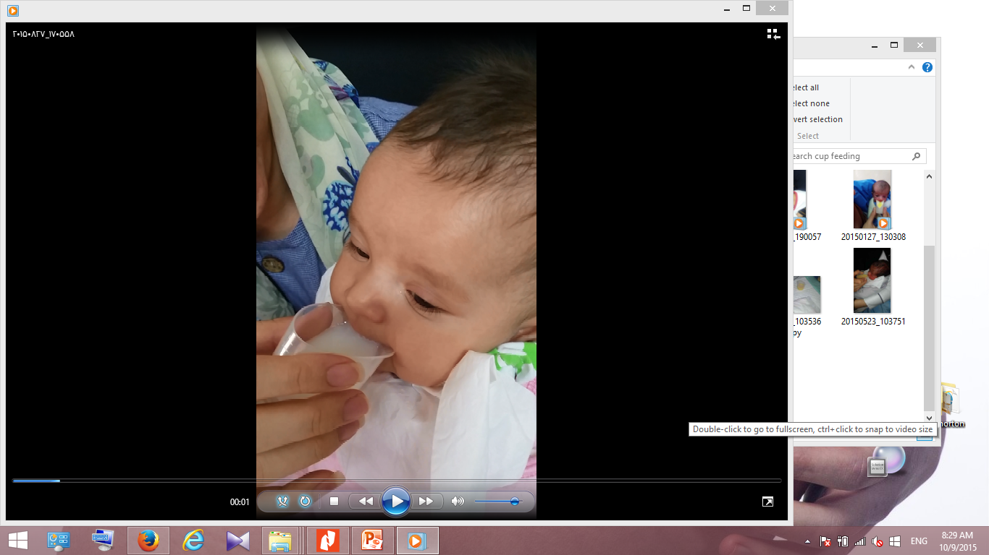
Cup feeding
Can be used for babies who are able to swallow but cannot (yet) suckle well enough to feed themselves fully from the breast.
They may have difficulty attaching well, or they may attach and suckle for a short time, but tire quickly before they have obtained enough milk.
A baby of 30-32 weeks gestation can often begin to take feeds from a cup.
می تواند برای نوزادانی که قادر به قورت دادن هستند اما نمی توانند (هنوز) به اندازه کافی شیر بخورند تا به طور کامل از سینه تغذیه کنند قابل استفاده است. آنها ممکن است در خوب چسبیدن مشکل داشته باشند، یا ممکن است برای مدت کوتاهی بچسبند و شیر بخورند، اما قبل از اینکه شیر کافی به دست آورند، به سرعت خسته می شوند. یک نوزاد در هفته های 30 تا 32 بارداری اغلب می تواند از فنجان غذا بخورد.
Dr Ravari

Slide 57


Cups
Almost any clean, small plastic or glass cup or bowl can be used to cup-feed, with the exception of disposal paper cups that may contain a plastic coating toxic to infants.
Cup-feeding supports breastfeeding by avoiding nipple or flow preference.
تقریباً از هر لیوان یا کاسه ای تمیز و کوچک پلاستیکی یا شیشه ای می توان برای تغذیه فنجانی استفاده کرد، به استثنای لیوان های کاغذی دور ریختنی که ممکن است حاوی پوشش پلاستیکی سمی برای نوزادان باشد.

Slide 58
Paladai cup
One form of cup, known as a paladai, is shaped like a gravy boat and is meant to be used to pour small amounts of fluid directly onto the baby’s tongue.
Aloysius and Hickson (2007) demonstrated increased spillage, increased length of feeding times, and more stress cues with use of the paladai cup in preterm infants.

Slide 59




Avoid bottle nipple preference

Slide 60

Compared to bottle feeding, preterm infants are more stable during cup feedings with lower heart rates, higher oxygen saturation, and lower oxygen desaturation because the infant controls the pace and volume of milk intake

Slide 61


ppears to be safe for preterm infants and may facilitate longer breastfeeding post discharge.
The parents need to understand that the method of feeding an infant via a cup is different from their own use of a cup. Infants can aspirate fluid if cup feeding is not performed Cup feeding askillfully.

Slide 62

Cup Feeding (best learned by watching and doing)
The baby should be in a calm, alert (not sleepy)
Sit the baby nearly upright position on your lap
Wrapped so that hands do not bump the cup
Support the baby’s back, head and neck.
Hold the small cup (30cc and about half full) of milk to the baby's lips
Place the rim of the cup on the baby's lower lip
Do not apply pressure to the lower lip
Tip the cup so that the milk just reaches the baby's lips
Leave the cup in the same position during the baby's pauses
When the baby has had enough, the baby closes his or her mouth and will not take any more
کودک باید در حالت آرام و هوشیار (نه خواب آلود) باشد. کودک را در وضعیت تقریباً عمودی روی پاهای خود بنشینید بسته بندی شده به طوری که دست ها به فنجان برخورد نکنند از پشت، سر و گردن کودک حمایت کنید. فنجان کوچک (30 سی سی و تقریباً نیمی پر) شیر را روی لب های کودک نگه دارید لبه فنجان را روی لب پایینی کودک قرار دهید به لب پایین فشار ندهید در طول مکث های کودک، فنجان را در همان وضعیت قرار دهید هنگامی که کودک سیر شد، کودک دهان خود را می بندد و دیگر مصرف نمی کند
شیر را در دهان کودک نریزید. فقط فنجان را روی لب های کودک بگیرید و اجازه دهید خودش آن را بگیرد

Slide 63
Tube Feeding Devices
دستگاه های تغذیه لوله
Supplementary Nursing System (SNS)
Finger Feeding
Tube-feeding
(SNS) سیستم پرستاری تکمیلی
تغذیه با انگشت
تغذیه لوله ای

Slide 64
Supplementary Nursing System (SNS)
Lactation aid
کمک شیردهی

Slide 65

Why Is The SNS Better?
Babies learn to breastfeed by breastfeeding
Mothers learn to breastfeed by breastfeeding
The baby continues to get the mother’s milk even while being supplemented
To allow extra milk (supplement)to be given while the baby is at the breast.
The baby will not reject the breast, which is very possible if supplementing off the breast

Slide 66
An SNS allows the baby to initiate or continue breastfeeding without the interruption of another form of supplementation not at the breast.
It enables both breastfeeding and supplementation to be done at the same time, decreasing the time spent to accomplish each feeding. A feeding can easily be consumed within the allotted 20 to 30 minutes
The SNS is the only supplemental feeding method that allows for continued skin-to-skin contact between mother and baby, further boosting the potential for increased maternal milk supply.
sns
به نوزاد اجازه می دهد تا شیردهی را بدون وقفه در شکل دیگری از مکمل غیر از سینه شروع کند یا ادامه دهد. این امکان را فراهم می کند که هم تغذیه با شیر مادر و هم مکمل ها به طور همزمان انجام شوند و زمان صرف شده برای انجام هر تغذیه کاهش می یابد. یک تغذیه را می توان به راحتی در 20 تا 30 دقیقه اختصاص داده شده مصرف کرد SNS تنها روش تغذیه تکمیلی است که امکان تماس مداوم پوست به پوست بین مادر و نوزاد را فراهم می کند و پتانسیل افزایش شیر مادر را افزایش می دهد.

Slide 67
Why Is The SNS Better?
Stimulating milk production (inadequate breast milk, relactation..).
Encouraging suckling.
Enabling closeness of mother and baby, In preterm baby, neurological and chromosomal abnormality.
To use a nursing supplementer the baby must be able to attach to the breast and suckle.
تحریک تولید شیر (شیر ناکافی مادر، واکنش...). تشویق شیر دادن امکان نزدیکی مادر و نوزاد، در نوزاد نارس، ناهنجاری عصبی و کروموزومی. برای استفاده از مکمل های شیردهی، کودک باید بتواند به سینه بچسبد و شیر بخورد.

Slide 68

Tape tubing just outside baby’s bottom lip, approx 5cm from the tip of your nipple
Notes:
The baby may be latched on to the breast first, and the tube slipped into the baby's mouth at the appropriate time
The better the latch, the better the baby will get your milk and the easier the aid will be to use,
The breast should be gently eased out of the way so that the corner of the baby's mouth is seen, and the tube, held between the index finger and thumb, should be slipped into the corner of the baby's mouth so that it enters straight towards the back of the baby's mouth.and It does seem to function better if the tube is placed into the baby's mouth over the tongue. (Point it slightly to the roof of the baby's mouth).
The tube is well placed when the supplemental fluid works its way down the tube at a rather rapid rate.
There is usually no need to fill the tube with supplemental fluid before putting it into the baby's mouth.
Or, the baby is latched on to the breast and the tube, which is run along the mother's breast and nipple, at the same time.
The tube may be taped to the breast if the mother desires, though this is not really necessary and not always helpful.
The tube does not need to pass the end of the nipple and needs to be only just past the baby's gums to function properly. It is occasionally helpful for the mother to hold the tube in place with her finger, as some babies tend to push the tube out of position with their tongues.
The bottle containing the supplement should not be higher than the baby's head
An appropriate flow rate accurse when the baby is able to breathe regularly while sucking, and only inhibit breathing in the moment of swallowing.
The supplementer should be slowed if the baby is
breath holding,
looking distressed,
coughing and
Sputtering
Do not cut off the end of the tube as cutting it makes the end sharp--it works fine as it is.
It should not take an hour for the baby to drink an ounce of milk from the lactation aid. If it is taking this long, the tube is probably not well positioned, or the baby is poorly latched on, or both. When the lactation aid is functioning well, it takes 15-20 minutes, usually less, for the baby to take 30 ml of the supplement.
Cleaning the Device
Do not boil the tube of the non-manufactured aid. It is not made to be boiled.
After using the device, clean the bottle as usual.
The tube should be emptied after use and then rinsed through with hot water (suck up hot water into the tube from a cup) and then hung up to dry.
Soap, though not necessary, may be used if desired, but rinse the tube well. Tubes may become stiff and unsuitable for use after a few days.

Slide 69





Slide 70



Slide 71

Introduction of Supplementation
معرفی مکمل
It is the most beneficial for the premature baby to get as much of the breast milk as possible so you should give
  the breast milk first and then
  finish the feeding with the Supplement with Cup or Supplementary Nursing System (SNS) . .…
برای نوزاد نارس این است که تا حد امکان شیر مادر را دریافت کند، بنابراین باید شیر مادر را به او بدهید. اول شیر مادر و بعد تغذیه را با مکمل با فنجان یا سیستم پرستاری تکمیلی(sns
تمام کنید

Slide 72




Slide 73
Finger Feeding
تغذیه با انگشت
If baby must be fed away from the breast and you don’t want to use a bottle, finger-feeding is another option.
اگر کودک باید دور از سینه تغذیه شود و شما نمی خواهید از شیشه شیر استفاده کنید، شیر دادن با انگشت گزینه دیگری است.

Slide 74


Positioning of tube for Finger Feeding
موقعیت لوله برای تغذیه با انگشت

Slide 75
This avoids the use of an artificial nipple.
Finger feeding is a method that helps train the baby to take the breast but instead, primarily to help latch on a baby who isn’t latching, therefore, finger feeding should not be used as a method of supplementation if baby is already latching on to the breast
However, in such a situation (baby is separated from the mother)a cup is probably a better method of feeding the baby.
Your nipples are so sore that you cannot put the baby to the breast.
این کار از استفاده از نوک پستان مصنوعی جلوگیری می کند. تغذیه با انگشت روشی است که به کودک کمک می‌کند تا سینه را آموزش دهد، اگر کودک از قبل به سینه می‌چسبد، شیر دادن با انگشت نباید به عنوان یک روش مکمل استفاده شود. شرایطی (کودک از مادر جدا می شود) احتمالاً فنجان روش بهتری برای تغذیه نوزاد است. نوک سینه های شما به قدری درد دارد که نمی توانید نوزاد را روی سینه بگذارید.

Slide 76

Finger feeding is much more similar to breastfeeding than bottle feeding
Baby must keep his tongue down and forward over the gums, the mouth wide open
It is important to encourage your baby to open his mouth widely before the finger is offered so that he learns the same skills he needs for breastfeeding.
Some lactation consultants also recommend using the finger or thumb that is closest to the approximate diameter of your nipple.
Dr Ravari
Notes:
Finger feeding (best learned by watching and doing)
1. Wash your hands. It is better if the fingernail on the finger you will use has been cut short, but this is not necessary.
2. It is best to position yourself and the baby comfortably. The baby's head should be supported with one hand behind
his shoulders and neck; the baby should be on your lap, half seated, and facing you. However, any position which is
comfortable for you and the baby and which allows you to keep your finger flat in the baby’s mouth will do.
3. You will need a lactation aid, made up of a feeding tube (#5French, 36" long), and a feeding bottle with an enlarged
nipple hole, filled with expressed breast milk or supplement. The feeding tube is passed through the enlarged nipple
hole into the fluid.
4. Line up the tube so that it sits on the soft part of your index, thumb, or middle finger. The end of the tube should
line up no further than the end of your finger. It is easiest to grip the tube, about where it makes a gentle curve,
between your thumb and middle finger and then position your index finger under the tube. If this is done properly,
there is no need to tape the tube to your finger.
5. Using the finger with the tube, tickle the baby's lips lightly until the baby opens up his mouth enough to allow your
finger to enter. If the baby is very sleepy, but needs to be fed, the finger may be gently insinuated into his mouth. Pull
the baby’s lower lip out if necessary. Generally, the baby will begin to suck even if asleep and receiving liquids will
then usually awaken him.
6. Insert your finger with the tube so that the soft part of your finger remains upwards. Keep your finger as flat as
possible, thus keeping the baby’s tongue flat and forward. Usually the baby will begin sucking on the finger, and allow
the finger to enter quite far. The baby will not usually gag on your finger even if it is in his mouth quite far, unless the
baby is not hungry or he is very used to bottles.
7. Pull down the baby's chin, if his lower lip is sucked in.
8. The technique is working if the baby is drinking. If feeding is very slow, you may raise the bottle above the baby's
head, but usually this should not be necessary. Try to keep your finger straight, flattening the baby's tongue. Try not
to point your finger up, but keep it flat. Do not apply pressure to the roof of baby’s mouth.
9. The use of finger feeding with a syringe to push milk into the baby's mouth is, in my opinion, too difficult for the
mother to do alone and definitely not more effective than simply using a bottle with the nipple hole enlarged and the
tube coming from it. The idea of finger feeding is not to feed the baby! The idea is to train the baby to suck
properly, so pushing milk into his mouth defeats the whole purpose of finger feeding.
If you are having trouble getting the baby to latch on to or to suckle at the breast, remember that a ravenous baby can
make the going very difficult. Take the edge off his hunger by using the finger feeding technique for a minute or so. Once
the baby has settled a little, and sucks well on your finger (usually only a minute or so), try offering the breast again. If you
still encounter difficulty, do not be discouraged. Go back to finger feeding and try again later in the feed or next feeding.
This technique usually works. Sometimes several days, or on occasion a week or more, of finger feeding are necessary,
however.

Slide 77

Finger-feeding with a syringe
تغذیه با انگشت با سرنگ

Slide 78
Finger-feeding with a syringe
The use of finger feeding with a syringe to push milk into the baby's mouth is too difficult and not more effective
Is “parent led” rather than “baby led,” allowing more parental control over milk flow.
This can be an advantage for babies who have trouble drawing the milk out of feeding tubes.
Eye and medicine droppers have also been used

Slide 79
Tube-feeding
Tube-feeding is used when the baby
  cannot yet swallow, or coordinate swallowing and breathing, or
  tires too easily and does not get enough milk.
While the health worker inserts the tube and prepares the syringe or dropper, mother can let the baby suck her breast.
The baby can be tube-fed in the kangaroo position.
تغذیه لوله ای برای نوزاد استفاده می شود هنوز نمی تواند قورت دهد، یا بلع و تنفس را هماهنگ کند، یا خیلی راحت خسته می شود و شیر کافی دریافت نمی کند.
Dr Ravari

Slide 80



KMC and Nutrition
Exclusive breastfeeding
Initially tube or cup feeding before breastfeeding is established

Slide 81

The newborn infant experiences the milk from the tube feed and at the same time can suckle at the breast

Slide 82
Bottles
Probably the most common and well known form of feeding a baby other than breastfeeding is by using a bottle.
Nipple confusion, flow preference
Decreases the amount of skin-to-skin contact with the mother during feedings, thereby having a negative effect on prolactin levels and milk supply and interfering with thermoregulation of the late preterm baby
Negatively influences maternal feelings of self-worth because the mother is unable to provide for her baby from the breast

Slide 83
Increased risk of contamination of bottle parts or of the fluid inside the bottle
Bottle feeding to have a negative effect on the frequency and duration of breastfeeding
Most important disadvantage of using bottles for late preterm infants is that bottle feeding often decreases physiological stability, resulting in decreased oxygen saturation, increased heart rate, and increased respiratory rate compared with breastfeeding

